Slide 1
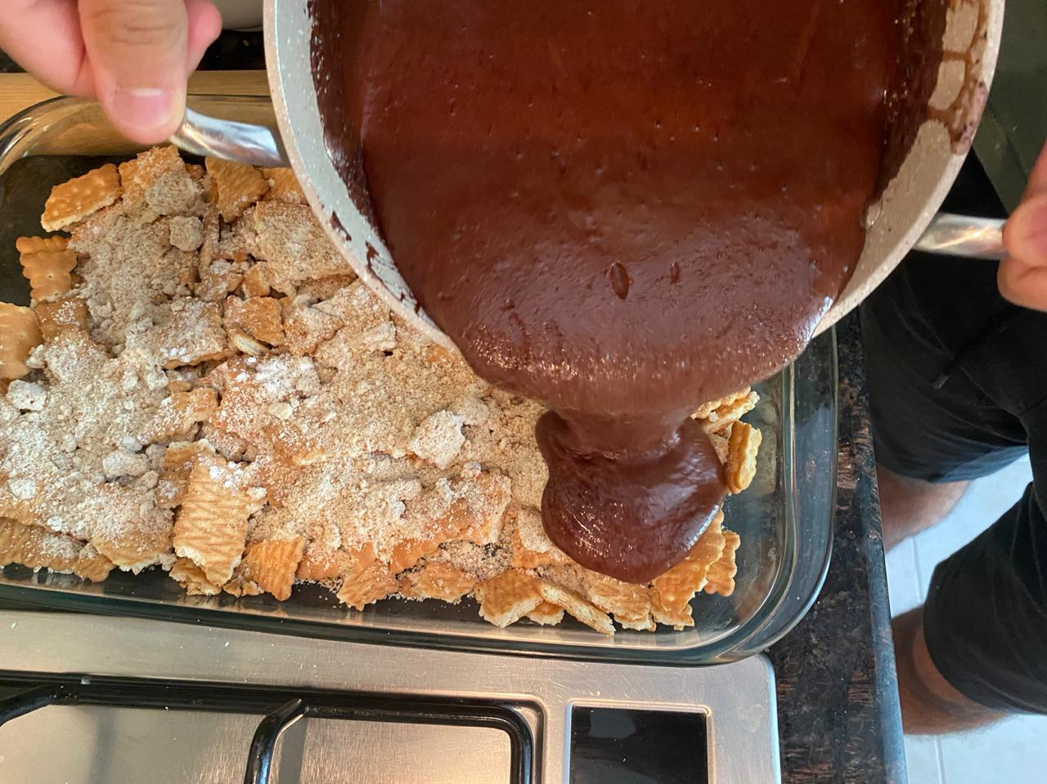


Week 1: Gratitude and Kindness
TIALT: reflect on the importance of being kind and showing gratitude
Activity 1- Three things I am grateful for today are:
1. Food in the house
2. Being safe from COVID-19
3. Having all the leisurely tools I have
Activity 2- FOUR things I can do to show kindness to people at home:
1. Saying things like ‘good morning’, ‘thank you’, ‘goodbye
2. Showing gratitude for what people give you
3. Do what your told by your elders
4. Keep each other safe by washing hands…
Activity 3 – My reflection:
I made dessert more my parents, this was because the days were becoming monotone so I decided to break the rhythm. I made a simple iced chocolate (because I am not a good cook). This cheered up the family gave us a good treat after the lunch

Slide 2

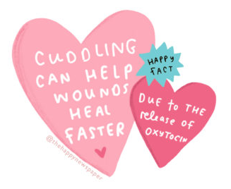
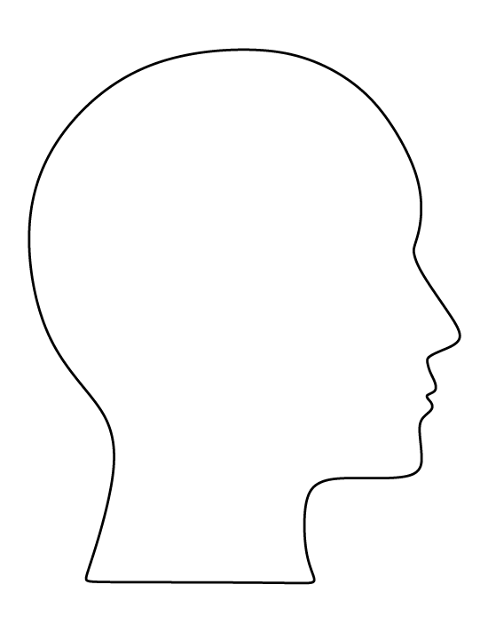

Week 1
Activity 4- Complete these activities – type into the boxes below:
3 things that I will really appreciate doing when this is all over:
I am most thankful for:
_____________Food, water, no virus, not being in a hotspot for the virus, leisurely tools._______________________________________________________________________________________________________________________
Words to describe how I feel right now:
Bored, concerned, lust for activities outside, sleepy.
1. Playing Tennis
2. Talking to people face to face
3. Getting out of the house
What I have learnt most from this experience:
Hygiene is important, that all viruses are deadly, food and water are very important
____________________________________________________________________________________________________________________________________

